Slide 1
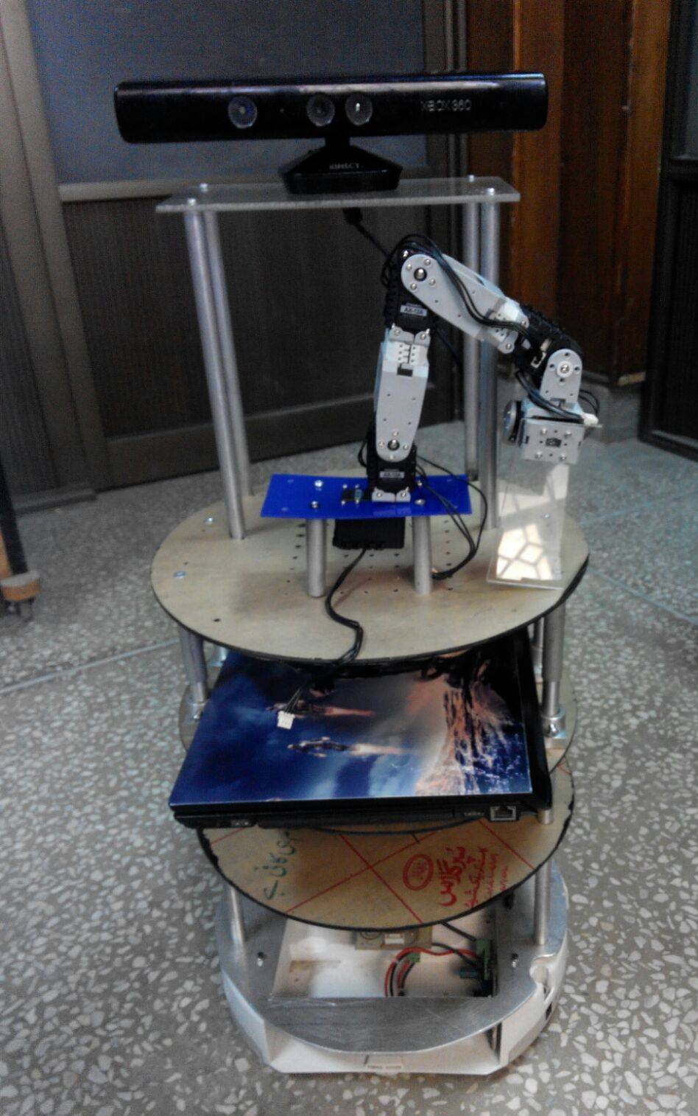
Intelligent Driving System
Supervisors:
Asst Prof Dr Waqar S Qureshi
Lecturer Fatma Faruq
Lecturer Aneeq uz Zaman
Amal, Minha, Anila, Maria & Rabeel

Slide 2


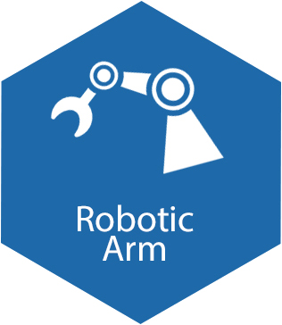
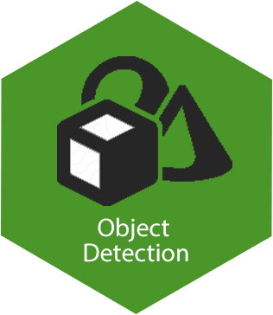
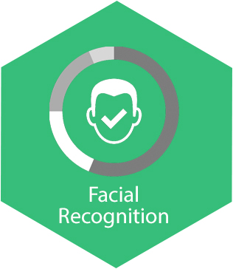

Introduction & Pictorial View

Slide 3
Deliverables
Localization and Mapping in dynamic environments
Navigation in dynamic environments
Voice Recognition & Synthesis
Sound Source Localization
Face Recognition
Person tracking
Object Recognition
Object Manipulation

Slide 4
Previous Work
SLAM
Creating a map of the environment
Rgbd-slam Algorithm -> 3D map
Store the 2D vision of the environment using Kinect
RVIZ simulation
Not implemented on hardware yet
Voice Recognition & Synthesis
The tasks they implemented were speech recognition and speech synthesis (partially)
And the API they used was that of GoogleNow known as artyom
Face & Object Recognition
Face detection → Open CV
Feature Based Approach applied
Eigen Faced Approach applied
Principal Component Analysis technique used

Slide 5
Our Progress
Linux file base system
ROS → ICRAI Workshop
Setup of lab
Literature Review
Most feasible Algorithms
ORB SLAM
HARK
HAAR based classifier
Hardware
Teleop
Kinect (7 to 12 volts)
Circuits
Power bank
Software
Gazebo, Rviz
Previous codes
Team Website

Slide 6
Work Distribution

Slide 7
Elapsed time since start of project | Milestone | Deliverable
1 month (November) | Research | Literature review giving comparison of SLAM Algorithims, voice recognition & synthesis and face detection algorithms
1 month (December) | Algorithm implementation & stimulation on ROS (Part 1) | Mapping, navigation & localization implementation, voice recognition & face recognition Algorithim implementation on ROS
1 month (January) | Hardware analysis and implementation (Part 1) | Mapping, navigation & localization implementation, voice & face recognition hardware implementation as well as FEM and structural analysis
1 month (February) | Algorithm implementation & stimulation on ROS (Part 2) | Robot follower & guider algorithms, voice synthesis and localization and object detection implementation on ROS
1 month (March) | Hardware implementation (part 2) | Robot follower & guider algorithms, voice synthesis and localization and object detection implementation on hardware
1 month (April) | Integration of codes | Integration of all individual modules
1 month (May) 1 month (June) | Final testing and running Debugging and perfection of codes | Practical working of bot Debugging and perfection of codes

